Slide 1
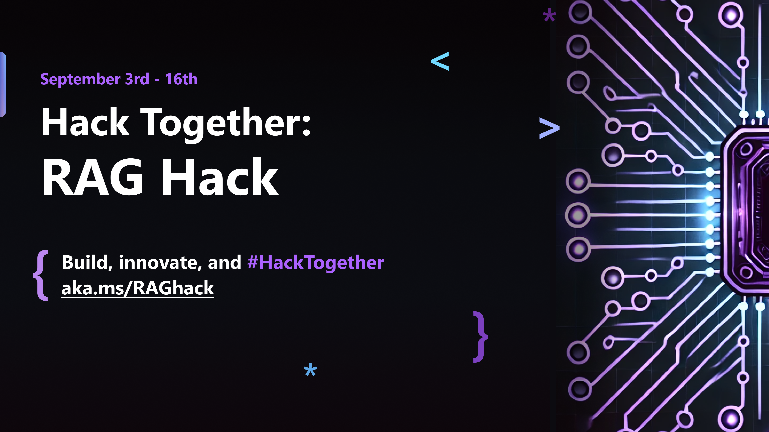

Slide 2
Add multi-channel communication to your RAG app
Milan Kaur, Senior Product Manager, Microsoft

Slide 3
Agenda
Logical layers of a RAG app
Azure Communication channels
WhatsApp channel for RAG app
Code walkthrough
PSTN channel for RAG app
Code walkthrough

Slide 4




RAG: Retrieval Augmented Generation
The Prius V has an acceleration of 9.51 seconds from 0 to 60 mph.
How fast is the Prius V?
vehicle | year | msrp | acceleration |
--- | --- | --- | --- | --- | ---
Prius (1st Gen) | 1997 | 24509.74 | 7.46 |
Prius (2nd Gen) | 2000 | 26832.25 | 7.97 |
Prius (3rd Gen) | 2009 | 24641.18 | 9.6 |
Prius V | 2011 | 27272.28 | 9.51 |
Prius C | 2012 | 19006.62 | 9.35 |
Prius PHV | 2012 | 32095.61 | 8.82 |
Prius C | 2013 | 19080.0 | 8.7 |
Prius | 2013 | 24200.0 | 10.2 |
Prius Plug-in | 2013 | 32000.0 | 9.17 |
User
Question
Document Search
Large Language Model

Slide 5
Logical layers of a RAG app
Source
Ingest
Store
Processing
Serve
Source system where documents are stored
Extract and load large volume of data to Store layer
It’s possible to use 3rd party ‘connector’ to ingest data from source and build index in Store layer
Store extracted data and vector data to provides relevant data for users
Store operational data
Compute data and run real-time and batch requests
AI for text understanding, summarization and embeddings
User facing layer for example, Web App or Chat
Monitoring
Monitor users’ prompt and response
Identity & Access
Access controls on the service and contents
Notes:
If you are curious how Azure Communication Services is coming into the mix. Let me bring you back to one of the first slides that Hyun showed us, which listed the key components of a data-based AI solution. I’d like us to shift our focus on Serve layer for a bit. The content that is created behind the scenes with LLM, data indexing, and other things is served to the user via the Serve layer. Serve is the window to all the goodness of generative AI and is basically the communication layer. How is this output from generative AI is communicated to the end users. That's why I am here, to give you little TED talk on Microsoft’s CPaaS i.e. Azure Communication Services. . It also has value for the processing layer but let me first give you an overview of this platform and then we will get back to the processing layer.

Slide 6






Serve
Real time audio
stream & transcriptions
Processing
VOIP/PSTN
User facing layer for example, chat, and voice
Compute data and run real-time and batch requests
AI for text understanding, summarization and embeddings
SMS/Chat
Raw video media access
WhatsApp
Messaging data
Notes:
OK service like I said service the user facing layer right and the default layer that we've seen that we are seeing across the board is being used with copilot or Bing chat or even you know third party applications is chat but I want to encourage you to think about other channels that would be beneficial to use with generative AI what about voice what if we take the chat bot what about voice um

Slide 7
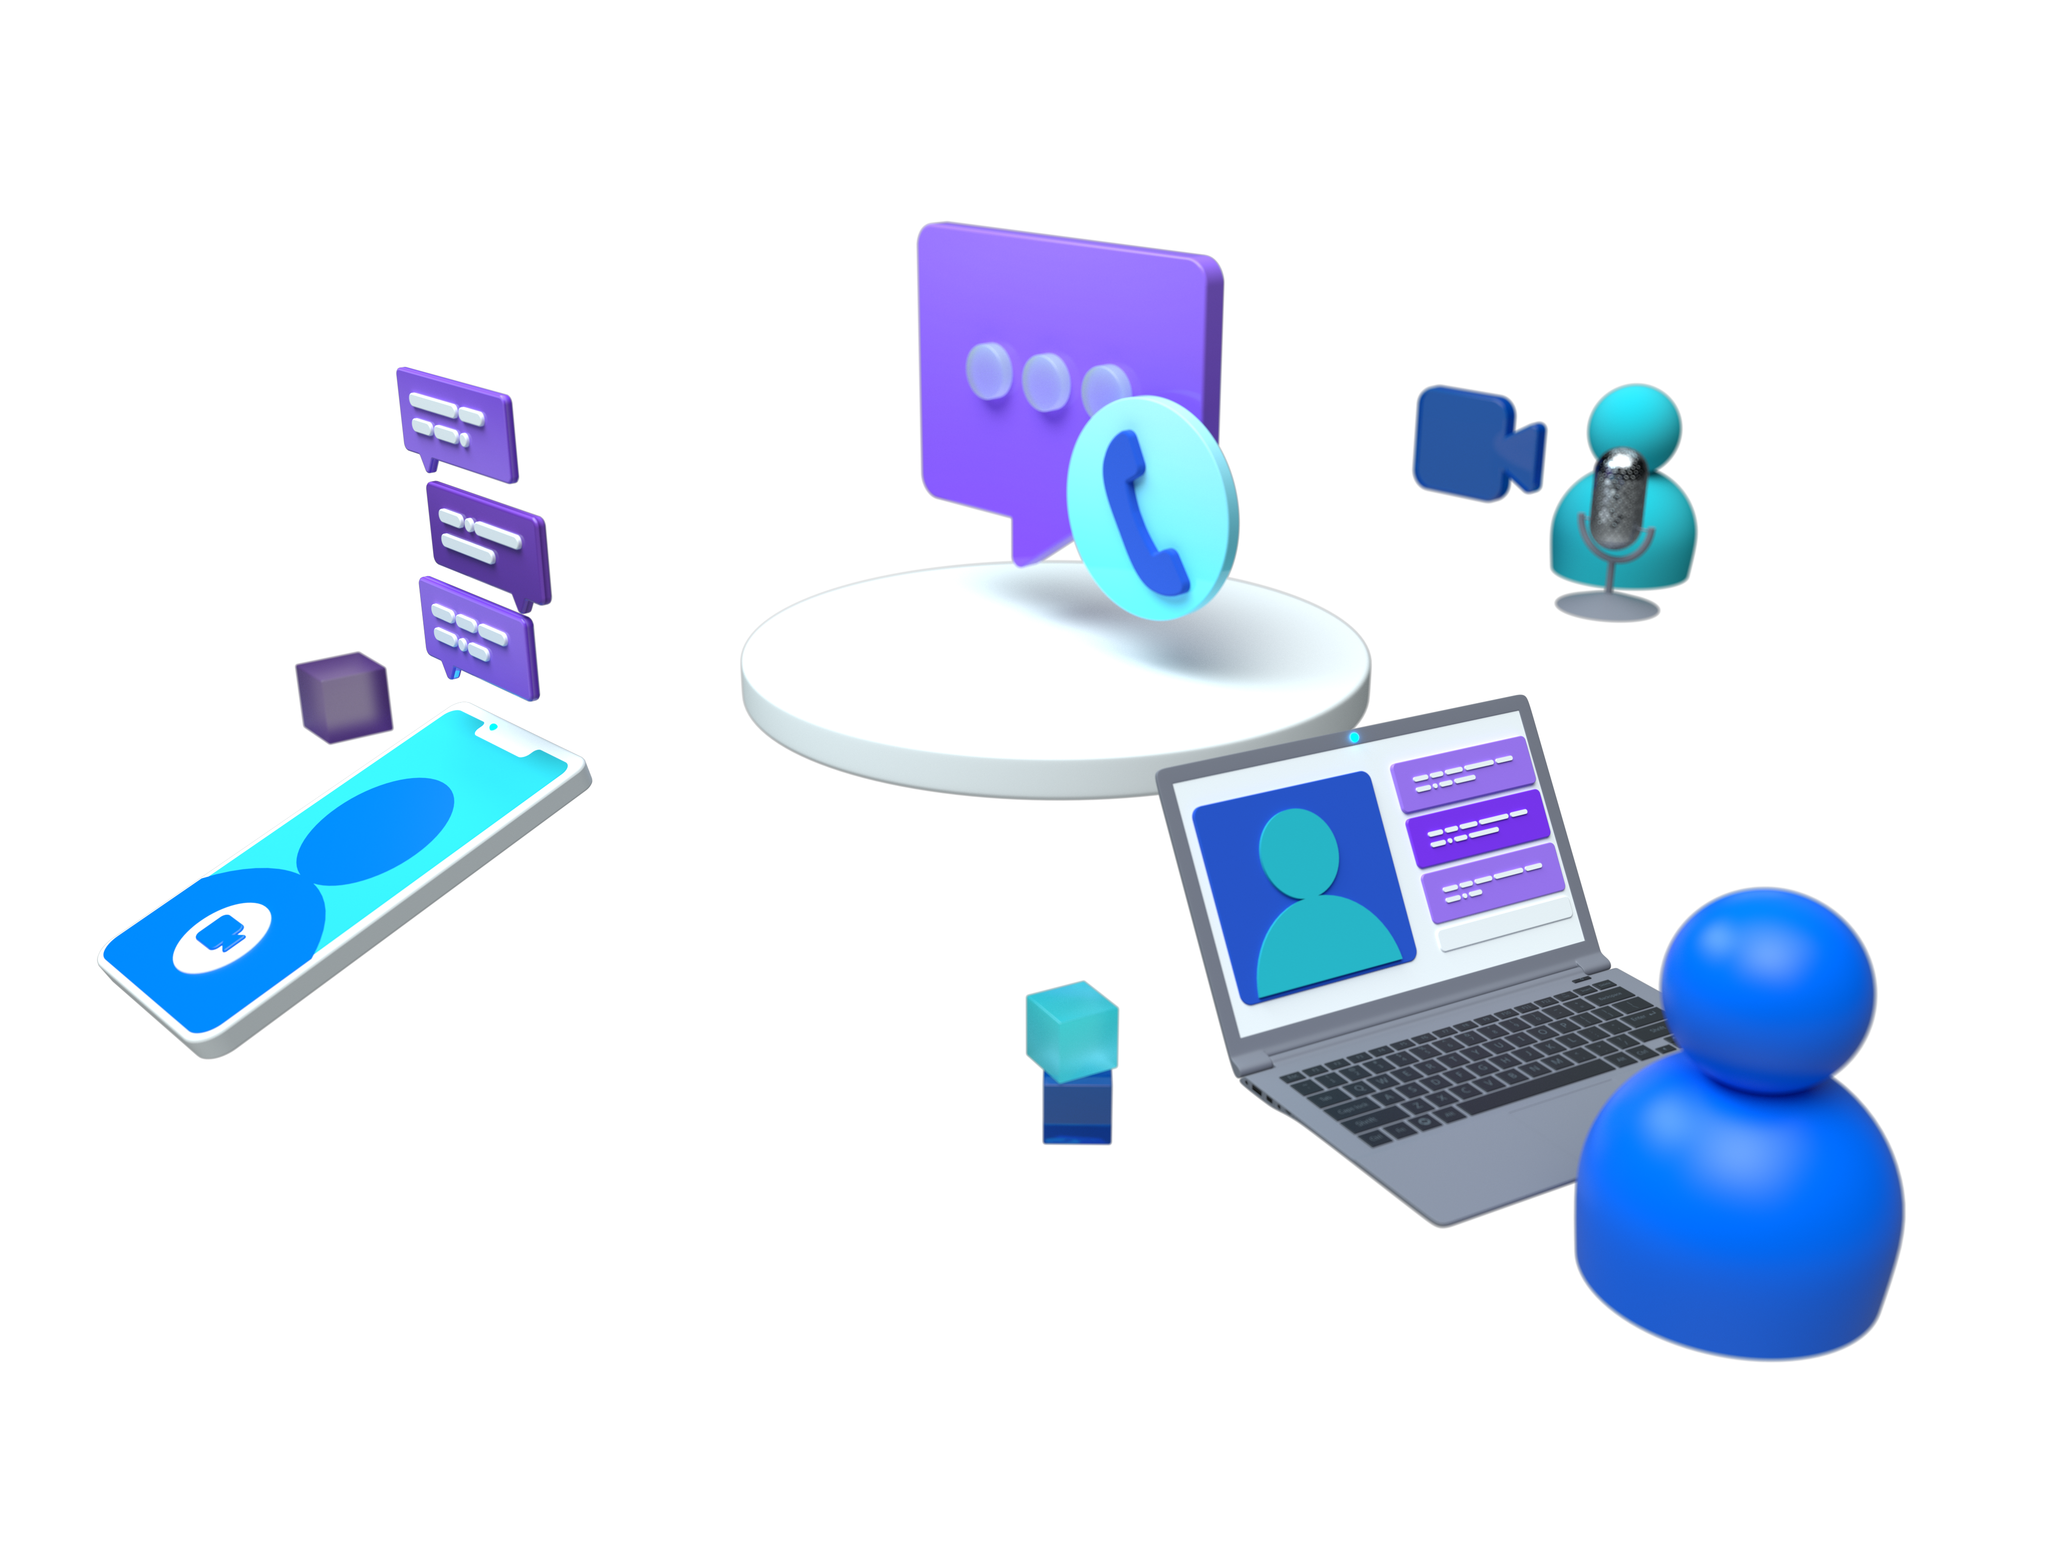
Azure Communication Services
A fully managed communication platform that enables developers and organizations to securely build communications features and connected user experiences across applications and devices.

Slide 8


Core communication services
REST API | Web, Mobile, Desktop SDKs
C# Java JavaScript Python
Voice & Video Calling | Chat | Telephony | SMS | Email | WhatsApp
Interactive, high quality audio and video calling that gets the job done | Add chat to your applications with an easy to use, low maintenance interface | Calling infrastructure To enable end-to-end communication scenarios | Reliably send and receive text messages with insights on deliverability and usage | Send transactional emails from application to customers | Send/Receive messages between Azure and WhatsApp users

Slide 9
Demo – WhatsApp channel for a RAG app Code Repo – aka.ms/whatsAppRag

Slide 10
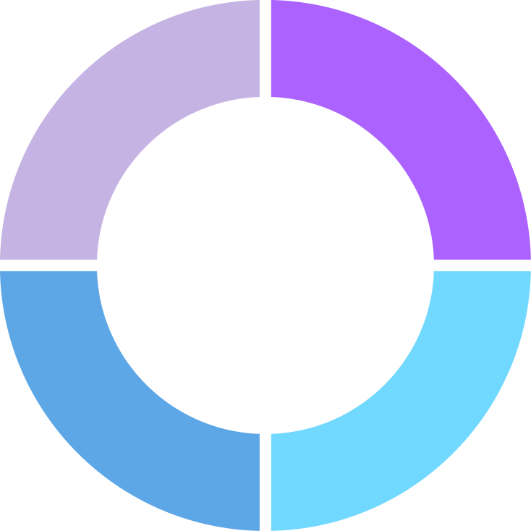
Scenarios
Order Inquiries
Appointment Queries
Booking | Shopping
Assistance
User Preferred Channel
Product Support

Slide 11
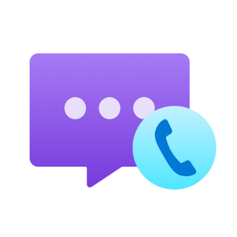


Architecture diagram
System Prompt, Conversation History
WhatsApp Messages
Notifications
User
ACS Messaging
Text Response
Your Application
Azure AI Search index for knowledgebase
Azure OpenAI Service
(GPT/ChatGPT)

Slide 12
Code snippets from Program.cs
Five easy steps
Step 1: Create an ACS resource
Step 2: Create a WhatsApp business account
Step 3: Connect your number or an ACS number with WhatsApp account
Step 3: Add ACS messaging library.
Step 4: Add code to send WhatsApp message
Step 5: Register your local or server url in ACS event grid for receiving WhatsApp messages
private async Task SendWhatsAppMessage(string numberToRespondTo, string message)
{
var recipientList = new List<string> { numberToRespondTo };
var textContent = new TextNotificationContent(
new Guid([WhatsApp channel registration Id from the portal]),
new List<string> { numberToRespondTo },
message);
await _notificationMessagesClient.SendAsync(textContent);
}
private async Task<IActionResult> HandleGridEvents(string jsonContent)
{
var eventGridEvents =
JsonSerializer.Deserialize<EventGridEvent[]>(jsonContent, _options);
foreach (var eventGridEvent in eventGridEvents)
{
if(eventGridEvent.EventType.ToLower() ==
"microsoft.communication.advancedmessagereceived":)
{
}
}
}

Slide 13
Pricing for WhatsApp messaging through Azure
- WhatsApp provides 1000 free conversations per month for conversations started by a customer.
Azure Communication Services costs $0.005/message per inbound and outbound message. You can apply your free Azure credits towards this.
More details here - Advanced Messaging pricing in Azure Communication Services - An Azure Communication Services concept document | Microsoft Learn

Slide 14
Demo – PSTN channel for a RAG app Code Repo – aka.ms/cakeShopSample

Slide 15

Architecture diagram
System Prompt, Conversation History
Phone Call
Call Events
User
ACS Cal Automation
Your Application
Azure AI Search index for knowledgebase
Azure OpenAI Service
(GPT/ChatGPT)
3
Respond To user
STT and TTS
4
Azure Communication Services
Azure AI Speech

Slide 16
Code snippets from Program.cs
Five easy steps
// Handle incoming call
app.MapPost("/api/event", async ([FromBody] EventGridEvent[] eventGridEvents) =>
{
if (eventGridEvent.EventType == "Microsoft.Communication.IncomingCall")
{
// Register call back url
// add logic
}
//Handle call back event such as recognize the speech of the customer, or call connected.
//These events are sent by the Event grid you need to configure in the ACS resource.
app.MapPost("/api/callbacks/{contextId}", async (CloudEvent[] cloudEvents, ILogger<Program> logger, [FromRoute] string contextId,
[Required] string callerId) => {
foreach (var cloudEvent in cloudEvents)
{
var parsedEvent = CallAutomationEventParser.Parse(cloudEvent);
if (parsedEvent is CallConnected)
{}
if (parsedEvent is RecognizeFailed recognizeFailed)
{}
// This event is generated when the speech is recorded by call automation //service. When the user on the other end of the line has completed their sentence
if (parsedEvent is RecognizeCompleted recogEvent
&& recogEvent.RecognizeResult is SpeechResult speech_result)
{}
}
Step 1: Create an ACS resource and get a number
Step 2: Add ACS Call Automation package.
Step 3: Create an endpoint for receiving incoming calls.
Step 4: Create an endpoint for receiving call back events.
Step 5: Deploy/run your app and register the call back url with ACS event grid.

Slide 17
Pricing for PSTN calls
The cost is associated per participant who are on the call. $0.004/min per app participant
$0.0013/min per PSTN participant (US number). Cost will differ based on the country. Find more details here. Cost calculations example for a call that lasts 10 minutes
The bot is a participant who has joined from the app : 1 participant x 10 minutes x $0.004 per participant leg per minute = $0.04
One participant on the PSTN outbound leg from Communication Services servers to a US telephone number x 10 minutes x $0.013 per participant leg per minute = $0.13.

Slide 18
Resources
Phone call sample - aka.ms/cakeShopSample
WhatsApp sample - aka.ms/whatsAppRag
Mechanics sample - aka.ms/acs-mech-sample
More ACS AI samples - aka.ms/acs-ai-samples
Quickstarts - aka.ms/acs-quickstarts

Slide 19
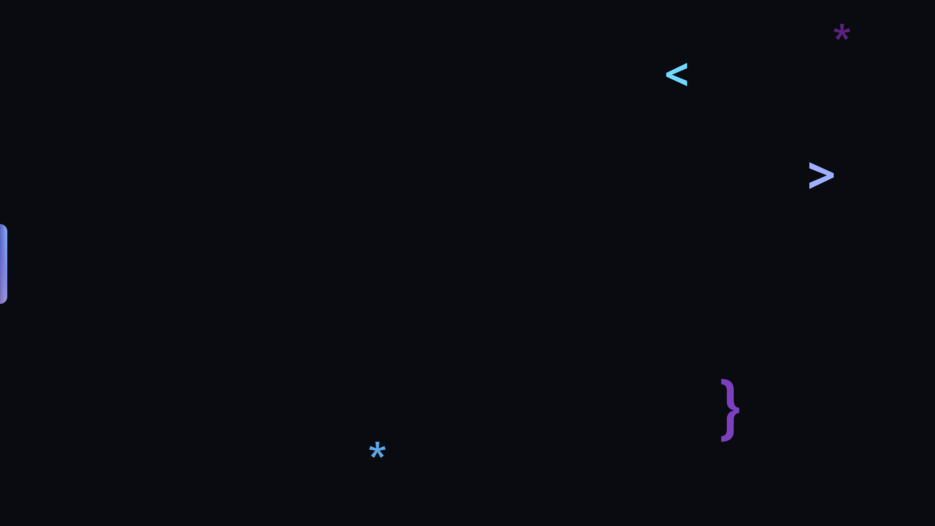
Thank you!

